Slide 1
Analysing Railway Infrastructure utilisation
A Geospatial Approach
Stuart Gordon
Supervisors: Dr Craig Robson, Professor Roberto Palacin
Oliver Bratton (Network Rail)

Slide 2
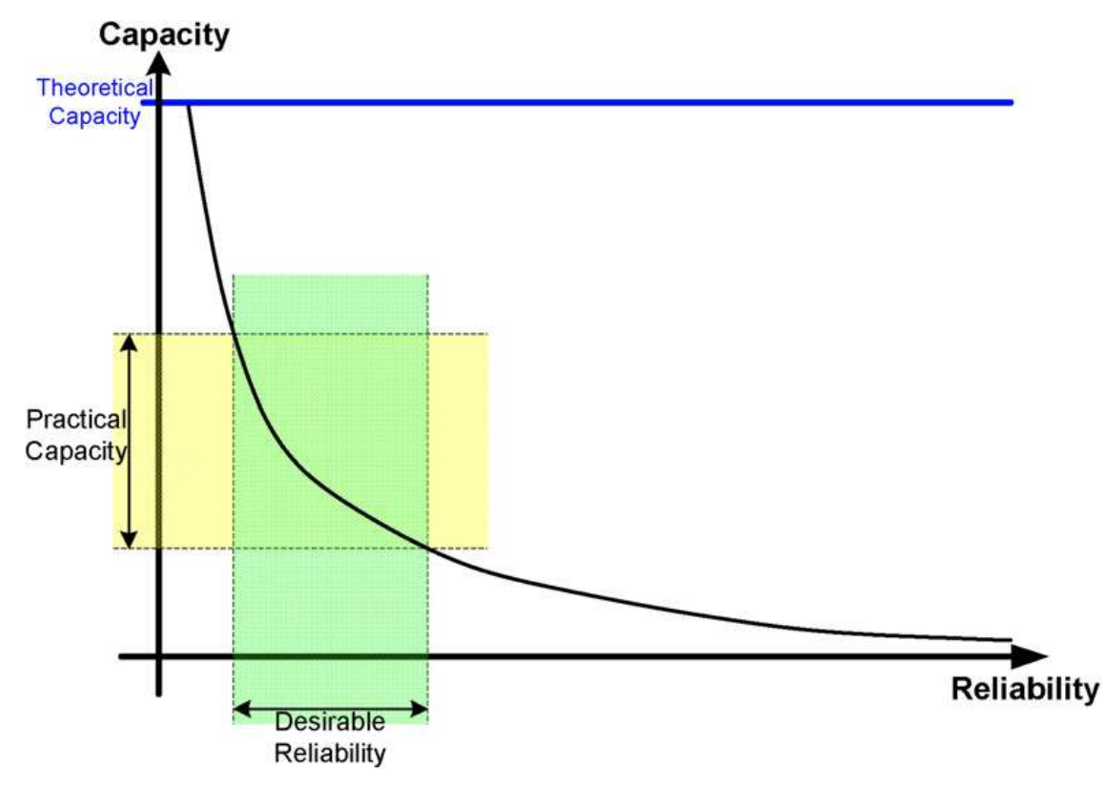
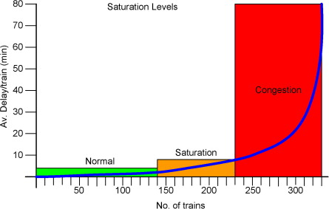
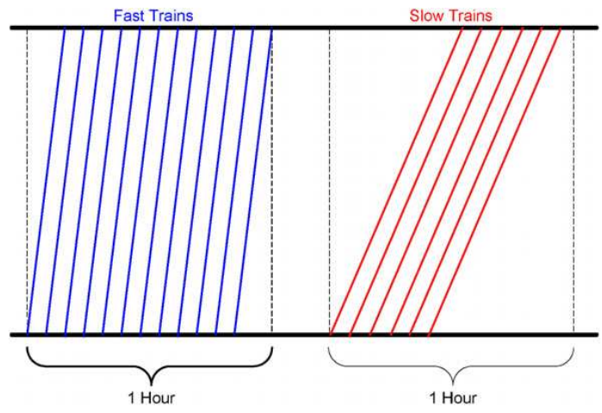
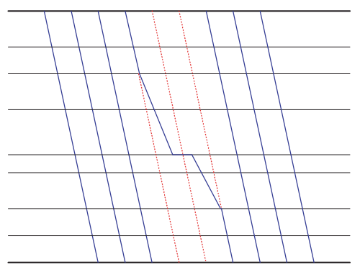
Railway Utilisation
Standard is UIC406
Simulation over topological models
Rare use of empirical data
No validation of real world predictions
Many variations of methods and methods to optimize
Abril et al, 2008. An assessment of railway capacity. Transportation Research Part E: Logistics and Transportation Review, 44(5), pp.774-806.

Slide 3

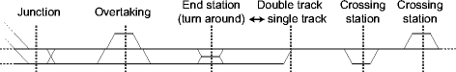
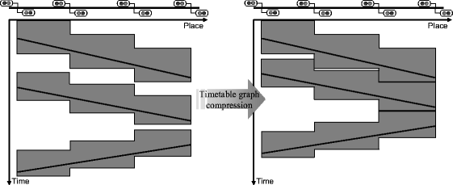




Literature
Logical Infrastructure linked to Timetable
Standard Approach UIC406
Simulation over topological models
Rare use of empirical data
No validation of real world predictions
Many variations of methods and ways to optimize
Landex, A. Evaluation of Railway Networks with Single Track Operation Using the UIC 406 Capacity Method. Netw Spat Econ 9, 7–23 (2009). https://doi.org/10.1007/s11067-008-9090-7
Notes:
Landex, A. Evaluation of Railway Networks with Single Track Operation Using the UIC 406 Capacity Method. Netw Spat Econ 9, 7–23 (2009). https://doi.org/10.1007/s11067-008-9090-7

Slide 4
Investigate Utilisation
Compare Planned against Actual Utilisation
Identify Events or Incidents
Aims

Slide 5
Geospatial Infrastructure
Spatial Temporal Graphs
Identify Differences in Utilisation
Realtime Processing
Objectives

Slide 6
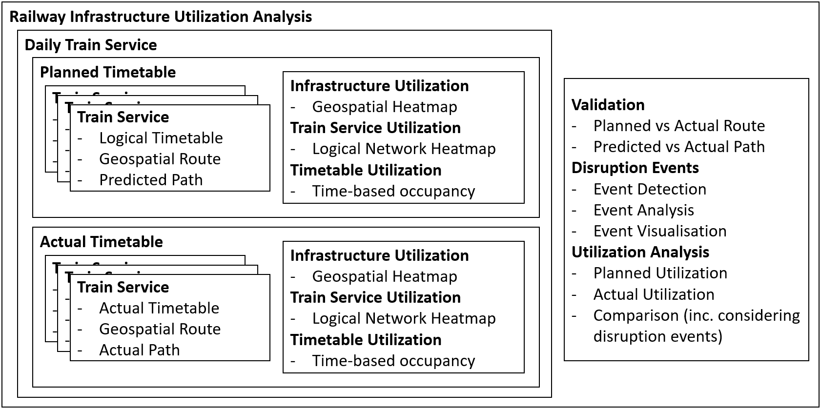
Methodology
Data Preparation
Data Processing
Calculation

Slide 7
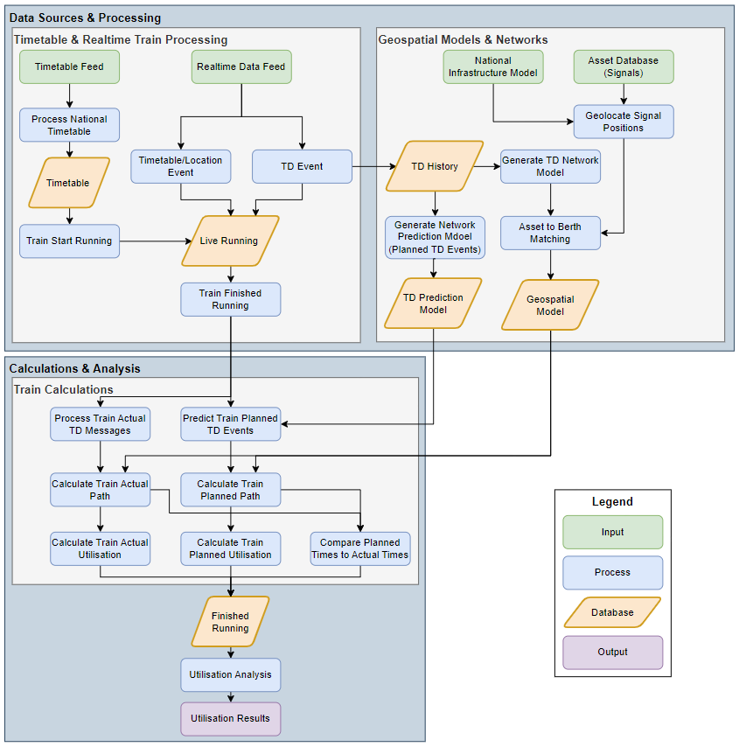
Process
Data Preparation
Data Processing
Calculation

Slide 8
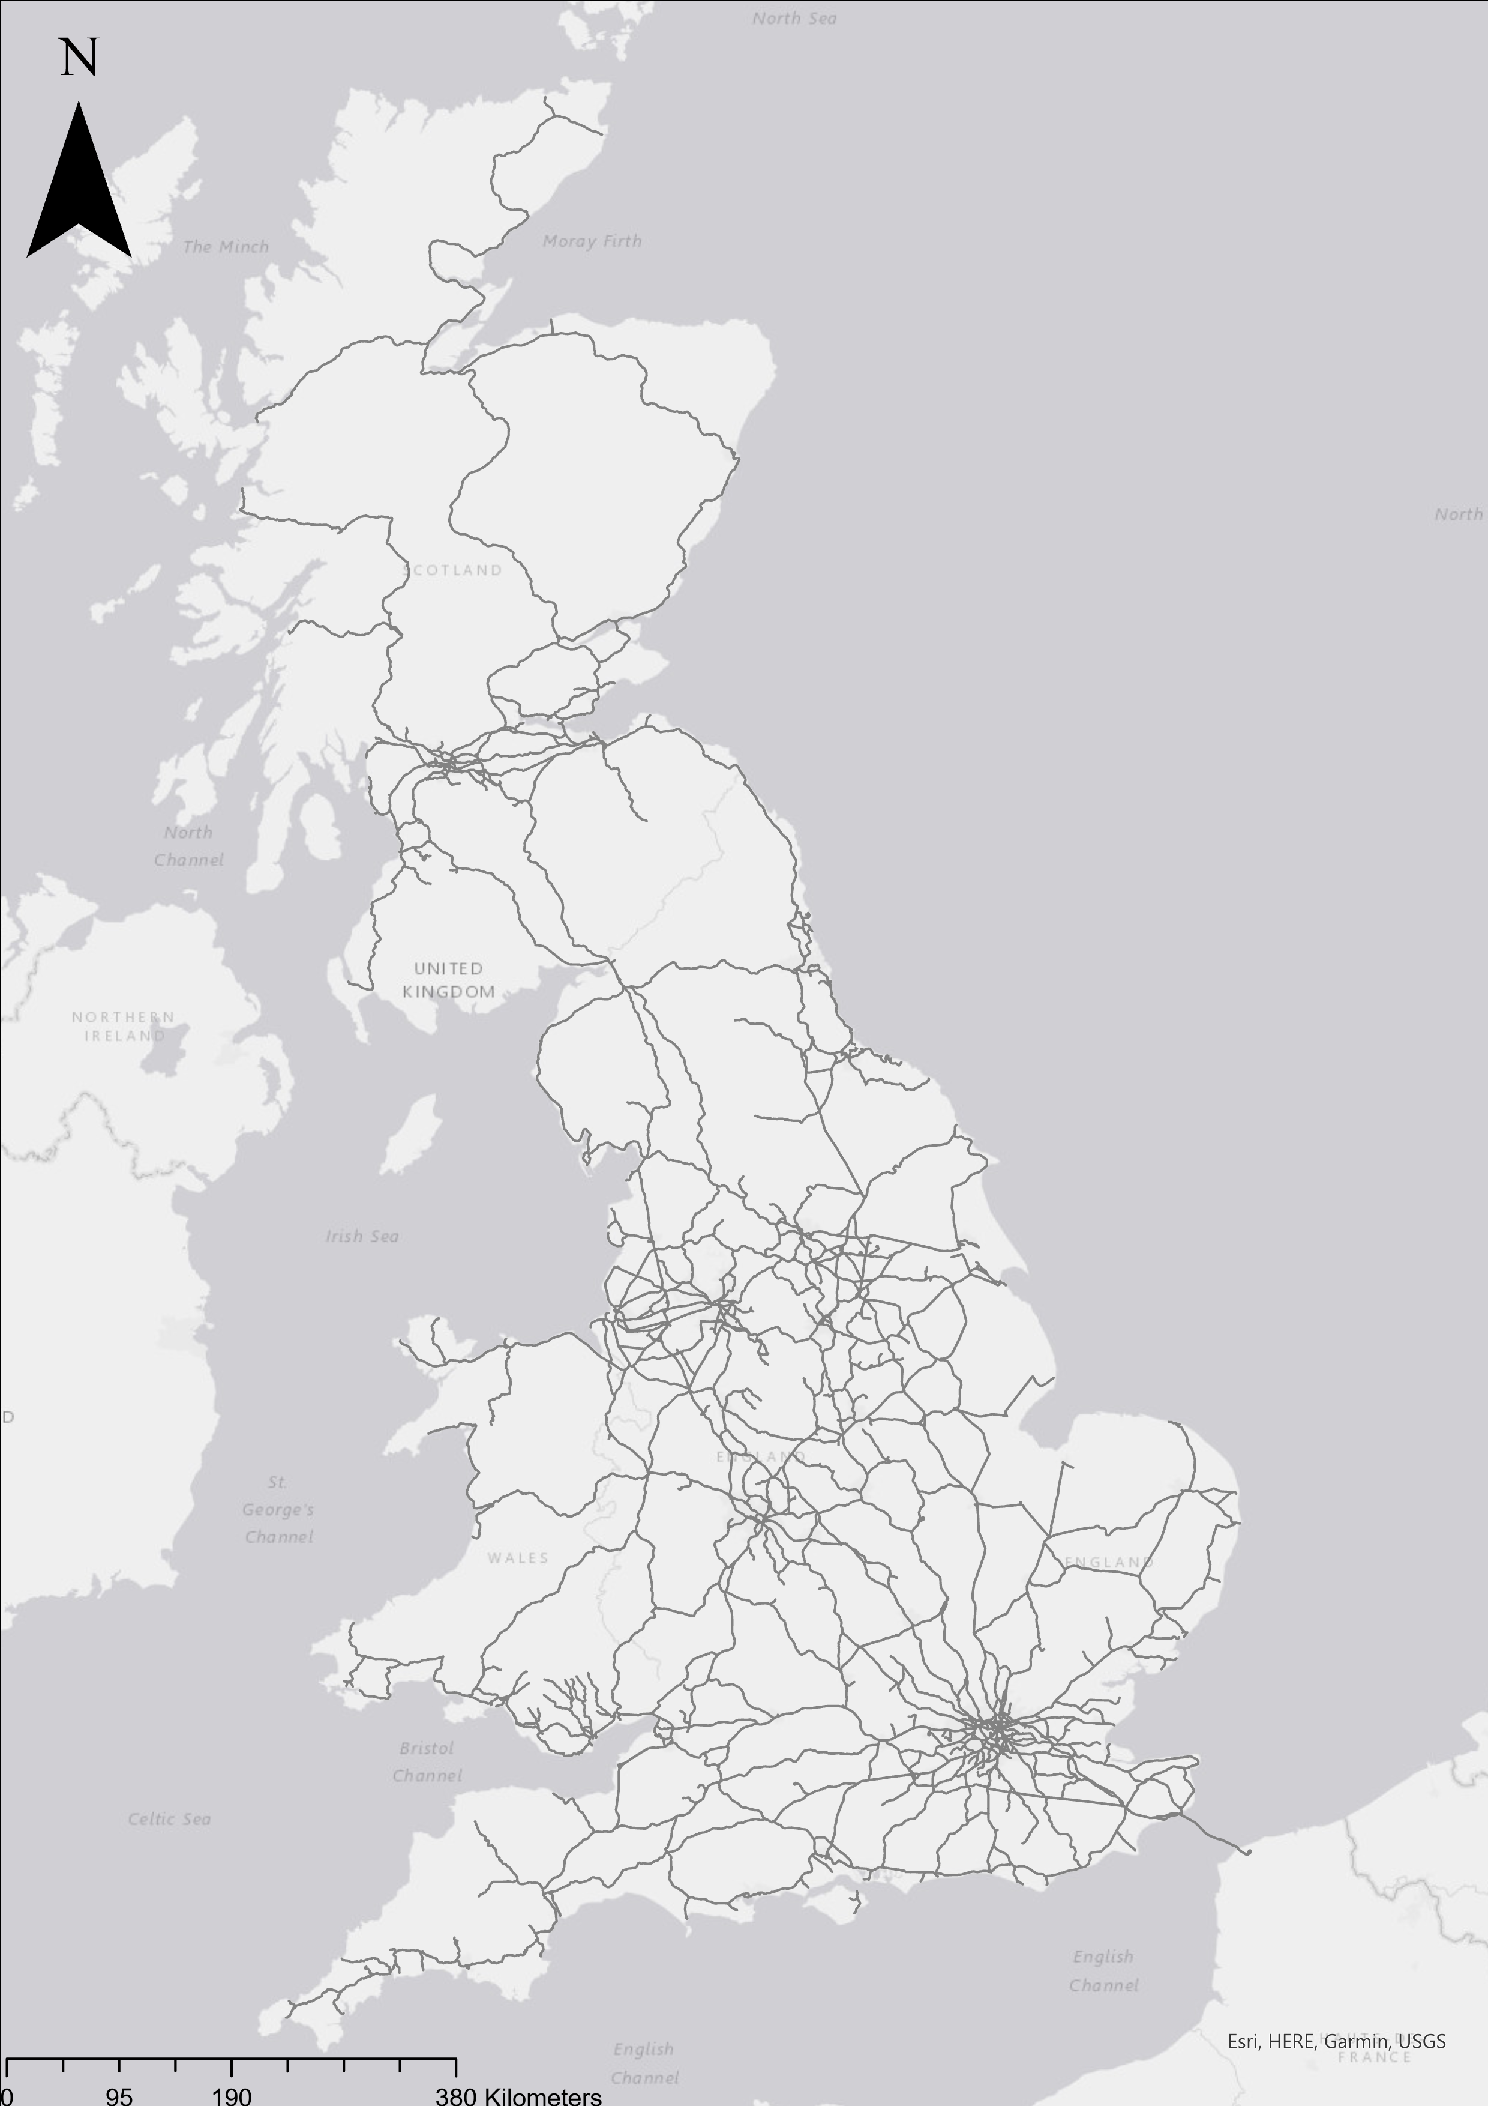
Scope
Over 20,000 Miles
15,416 edges

Slide 9
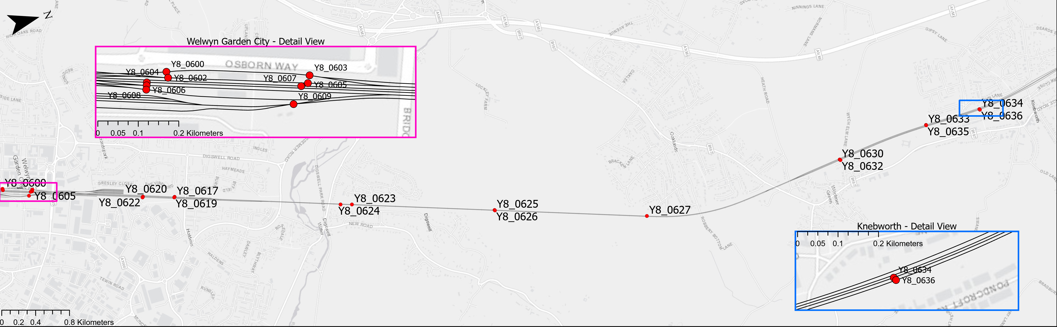
Data Preparation
Geospatial Model
Physical Assets

Slide 10
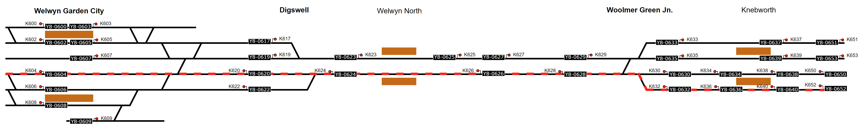
Data Processing
Logical Diagram
Logical Path

Slide 11
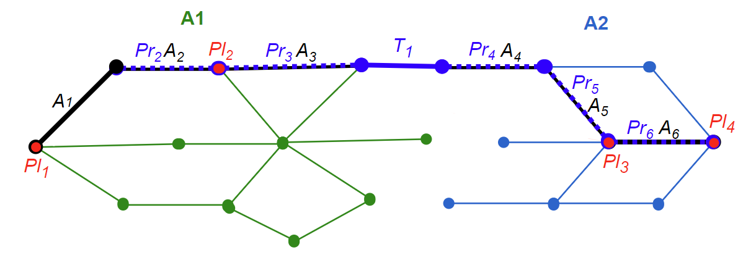
Data Processing
Actual Network Path
Predict Planned Path
Probabilistic Prediction Model
Modal next edge
Mean edge duration
A1 A2 Train Describer Networks
A_{n} Actual Network Path
Pl_{n} Timetabled locations
Pr_{n} Predicted Planned Path
T_{n} Transitions between Networks

Slide 12
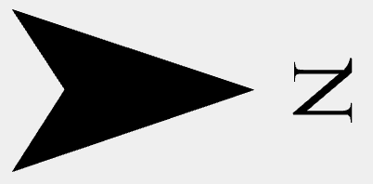
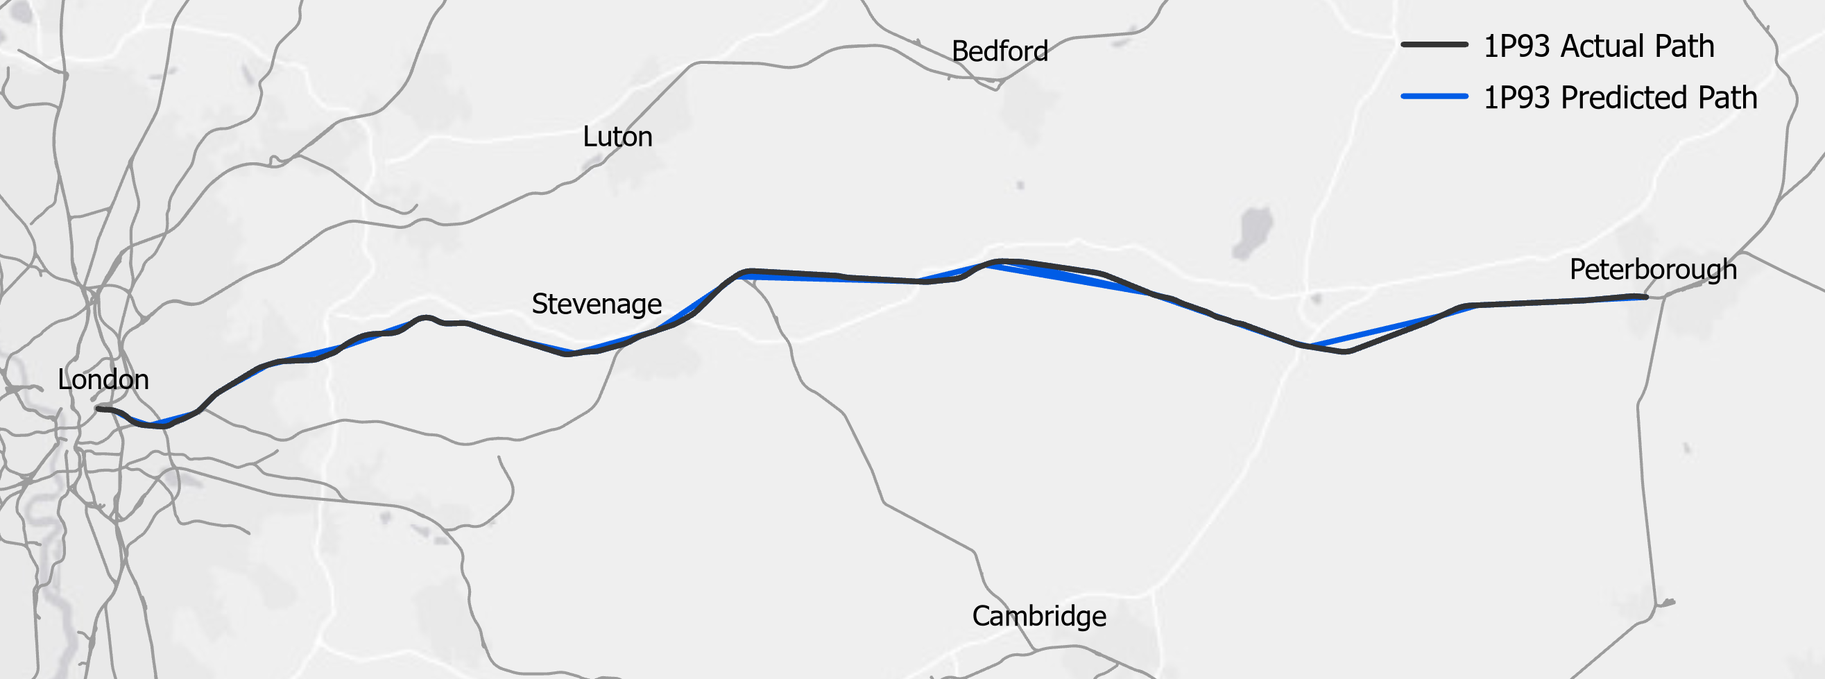
Calculation
Geospatial Route
Utilisation

Slide 13
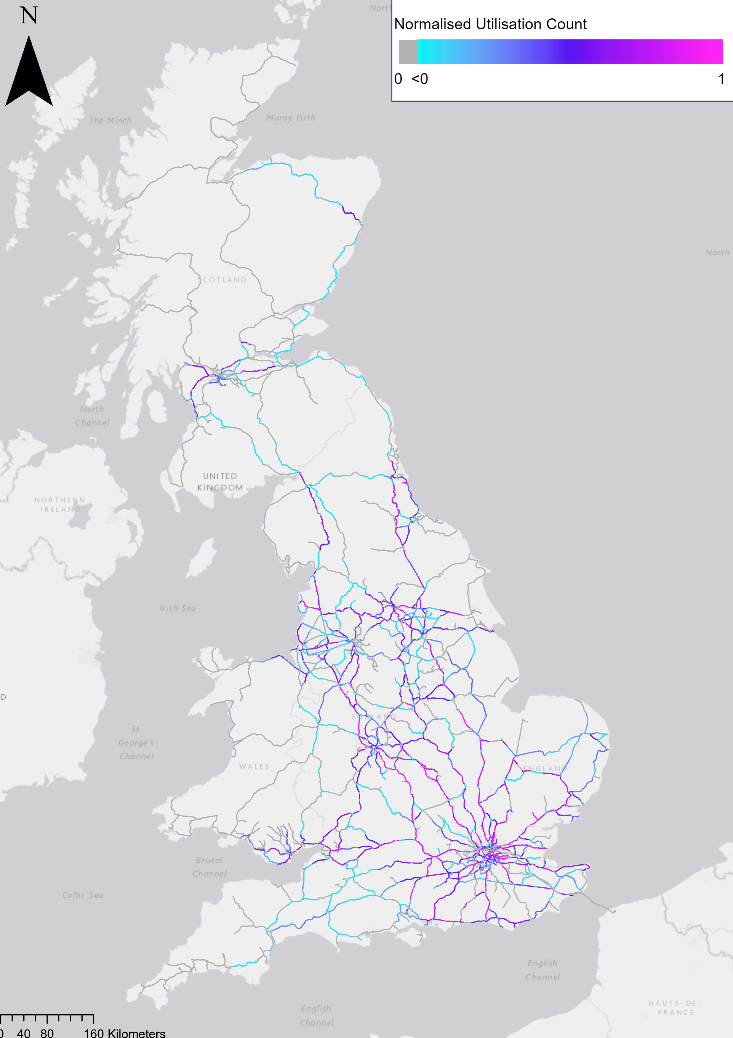
Calculation
Geospatial Route
Utilisation

Slide 14
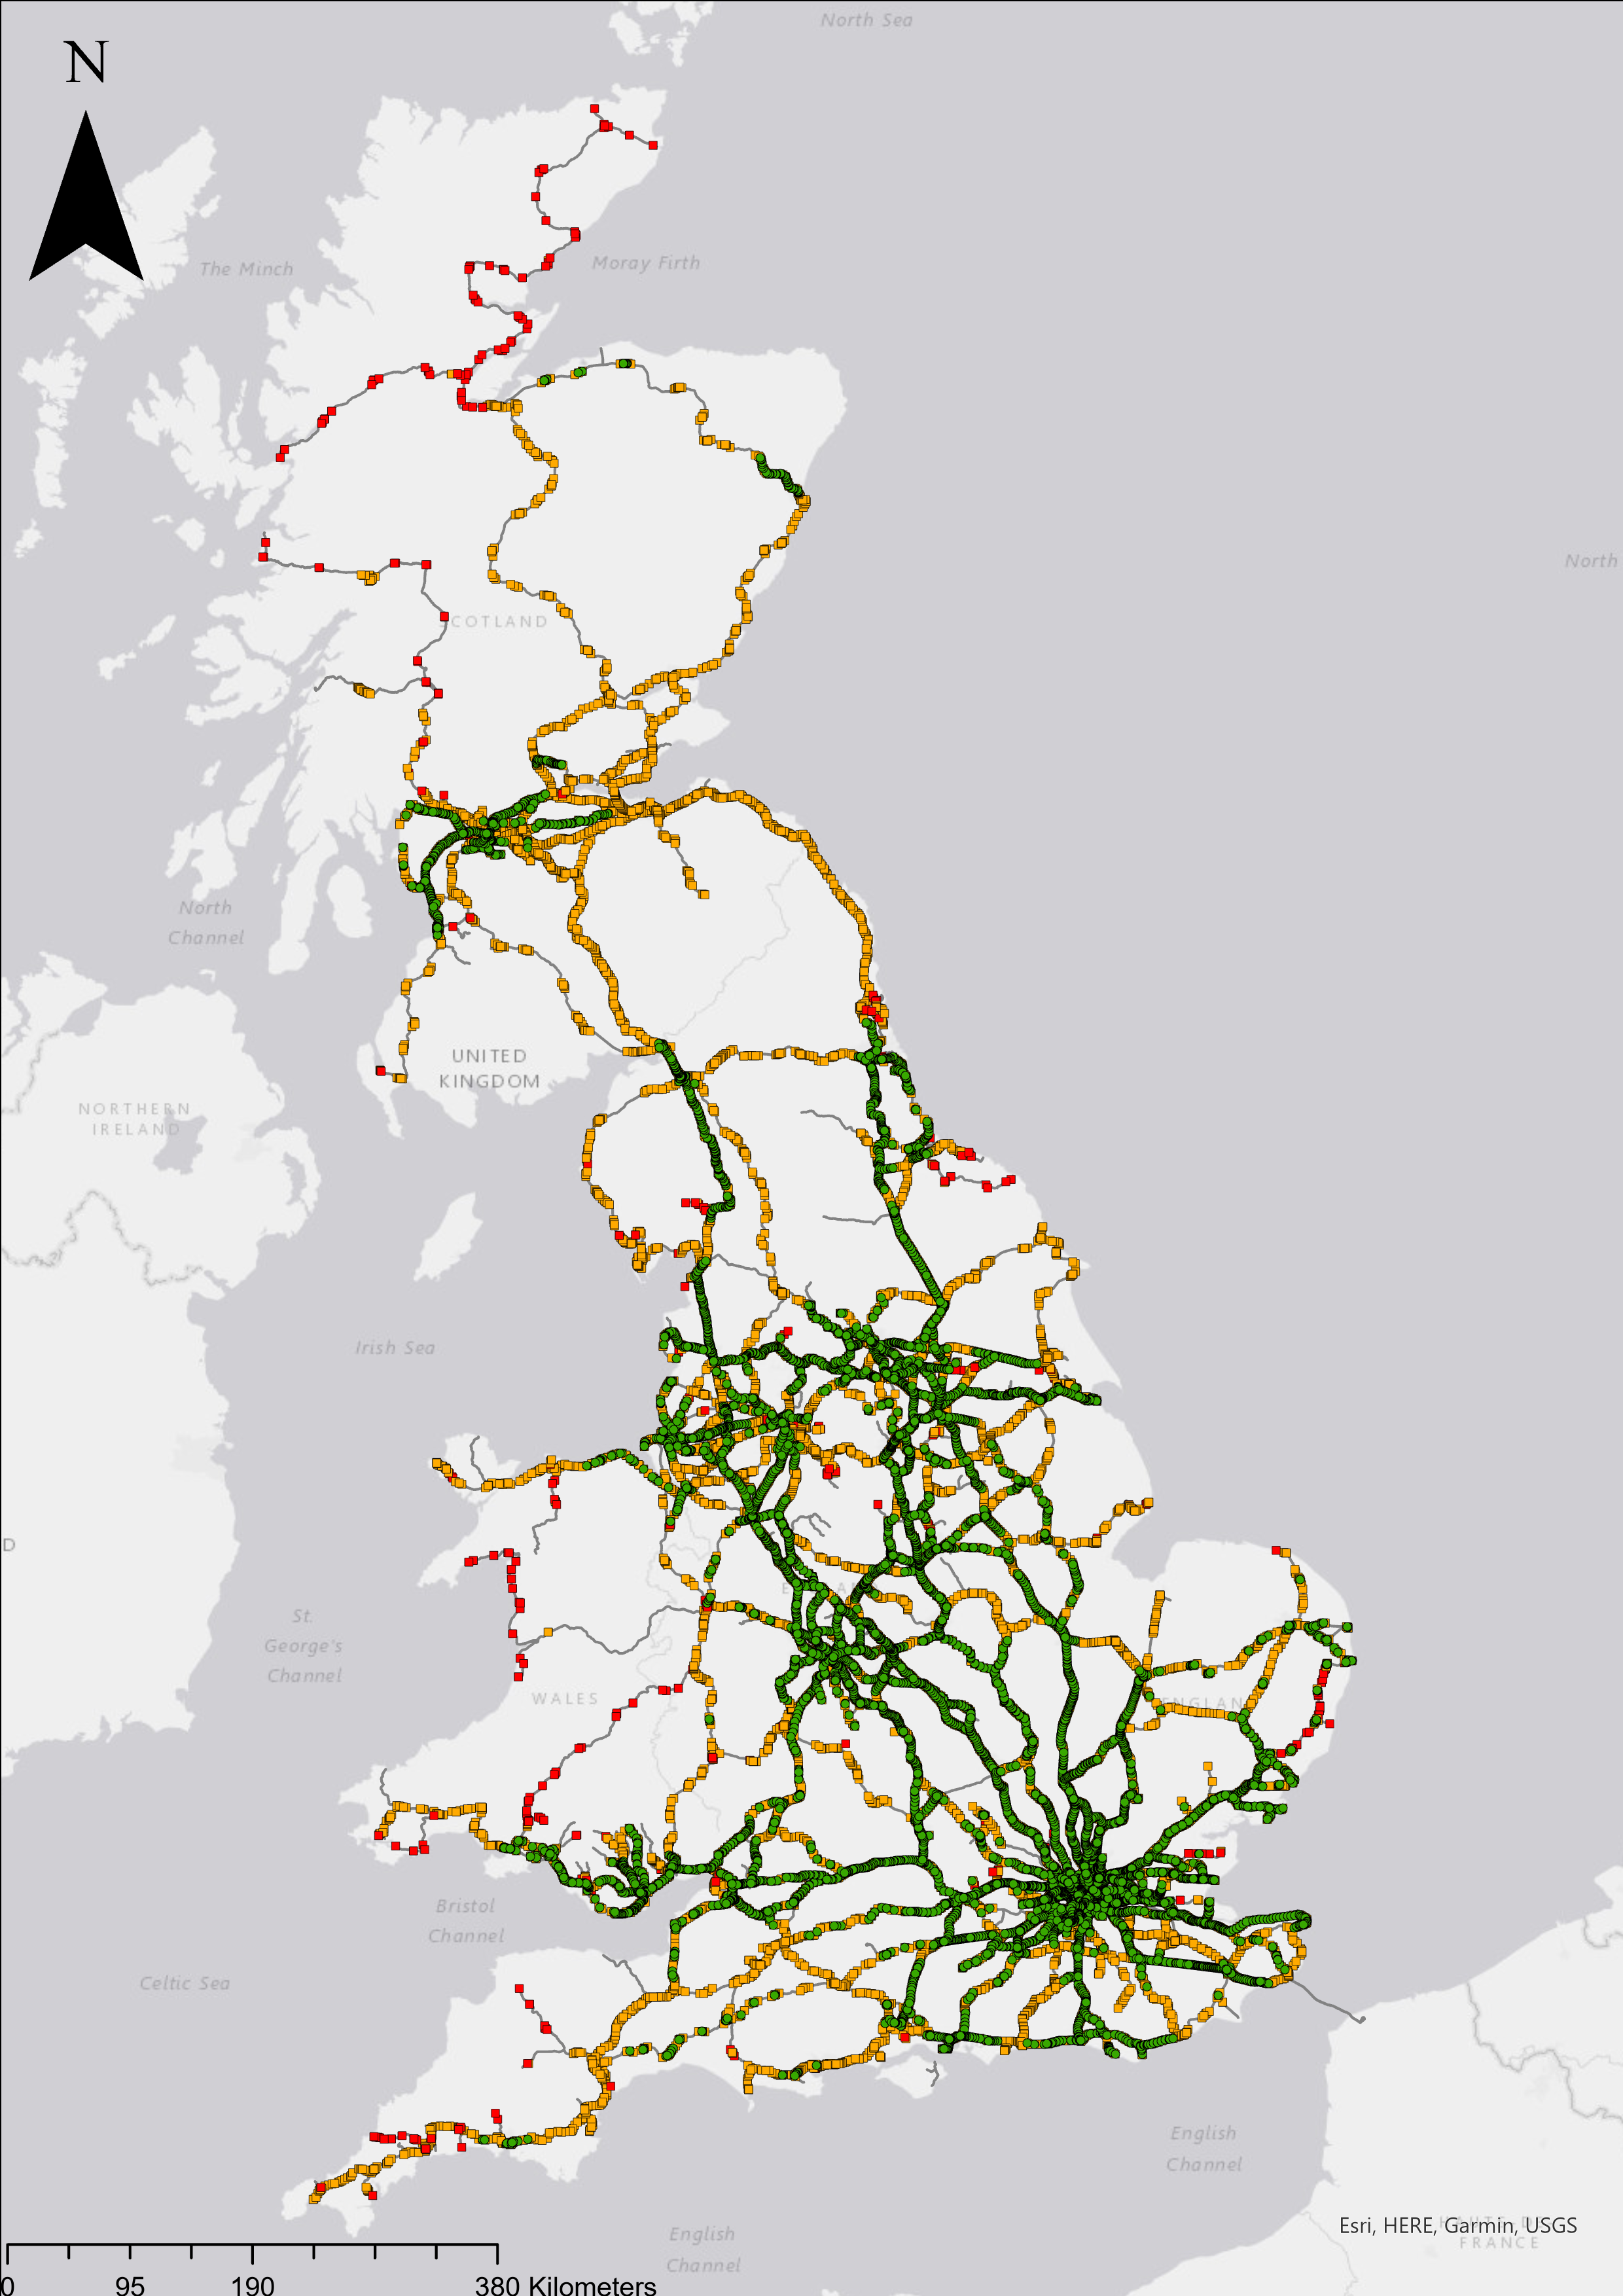
Challenges
Data quality
Data availability
Impact of Poor Data

Slide 15
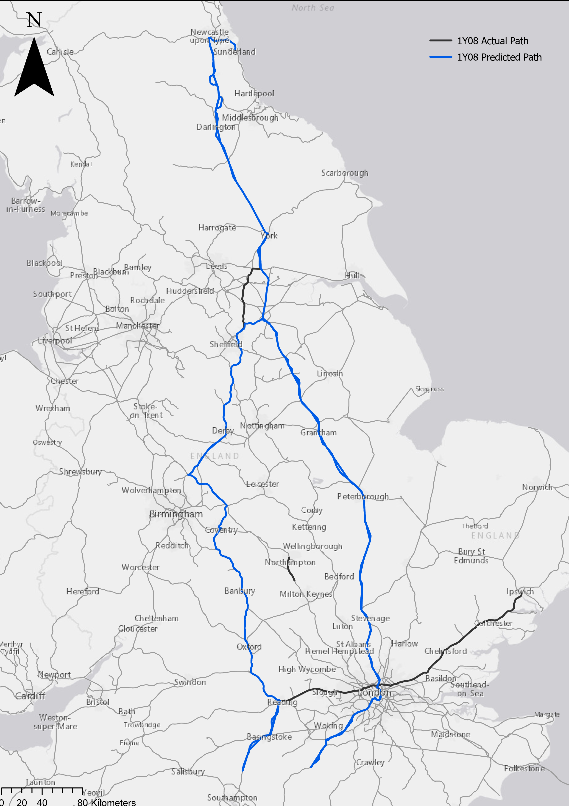
Challenges
Data quality
Data availability
Impact of Poor Data

Slide 16

Results
11th to 23rd July 2023
26.5 million train movements
7.8 million planned locations
149,473 out of 181,181 trains successfully calculated (82.50%)
Normalized Actual Utilisation
Normalized Planned Utilisation

Slide 17
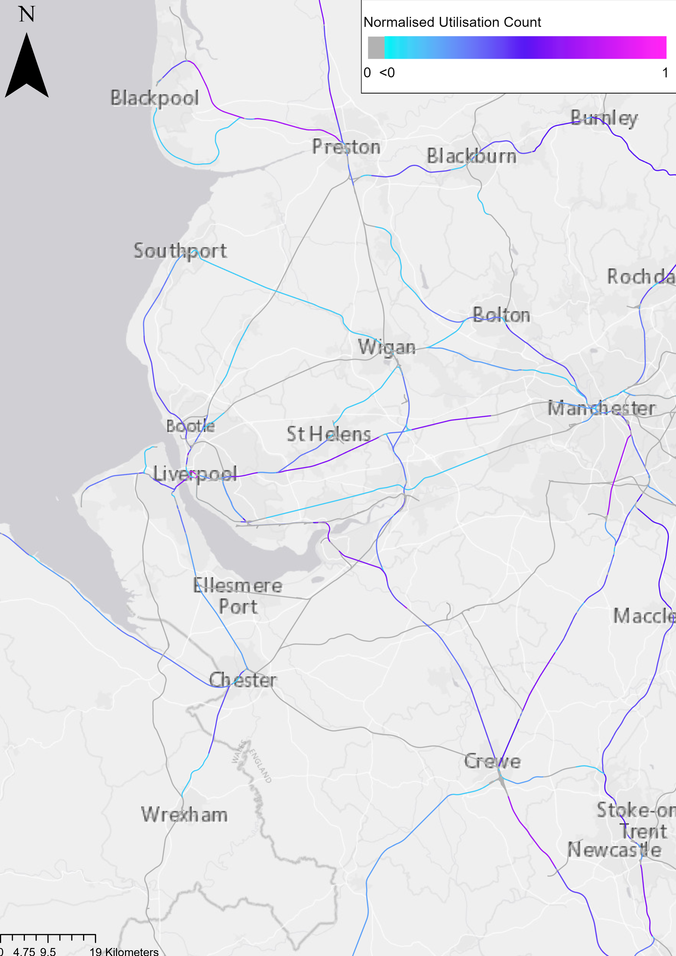

Results
Industrial Action 20th July
On Strike:
TransPennine Express
Northern
Avanti West Coast
Not On strike:
Merseyrail
Transport for Wales
19th July Normalized Actual Utilisation
20th July Normalized Actual Utilisation

Slide 18
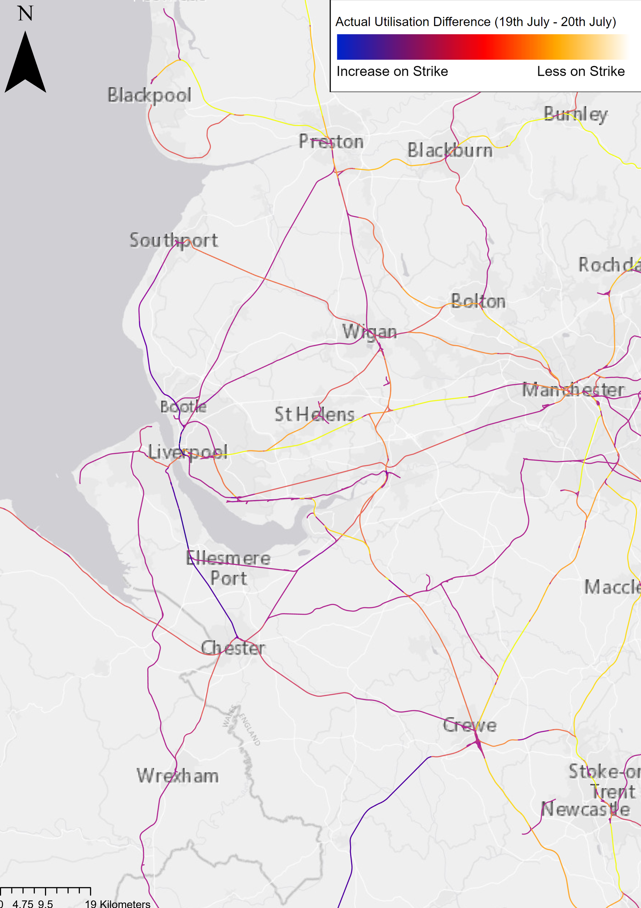
Results
Industrial Action 20th July
On Strike:
TransPennine Express
Northern
Avanti West Coast
Not On strike:
Merseyrail
Transport for Wales
Actual Difference between 19th & 20th July 2023

Slide 19
Conclusions
Method has potential, strike days indicate this
Currently limited by data quality and availability
Actual Difference between 19th & 20th July 2023

Slide 20
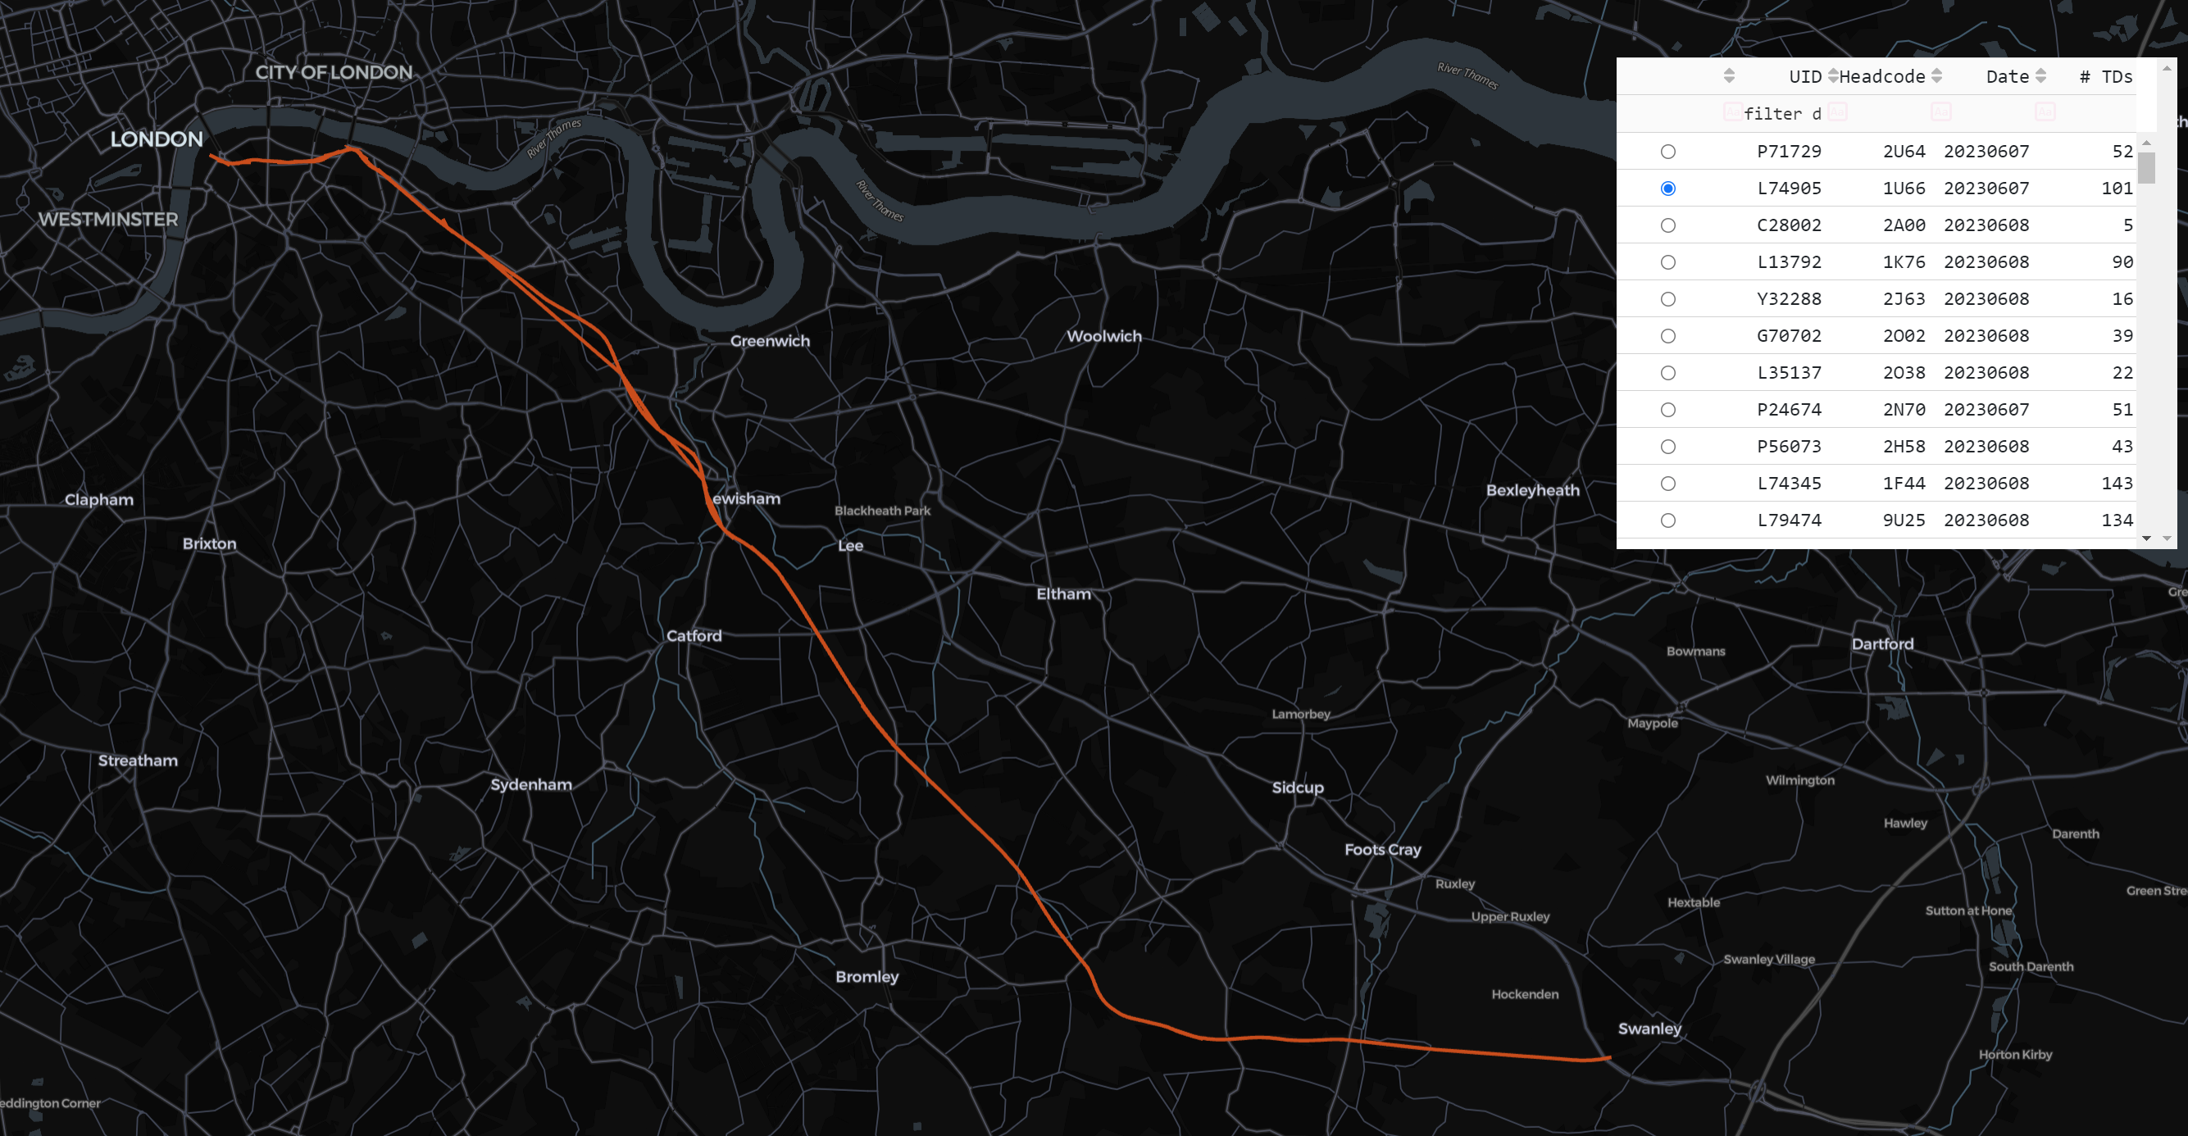
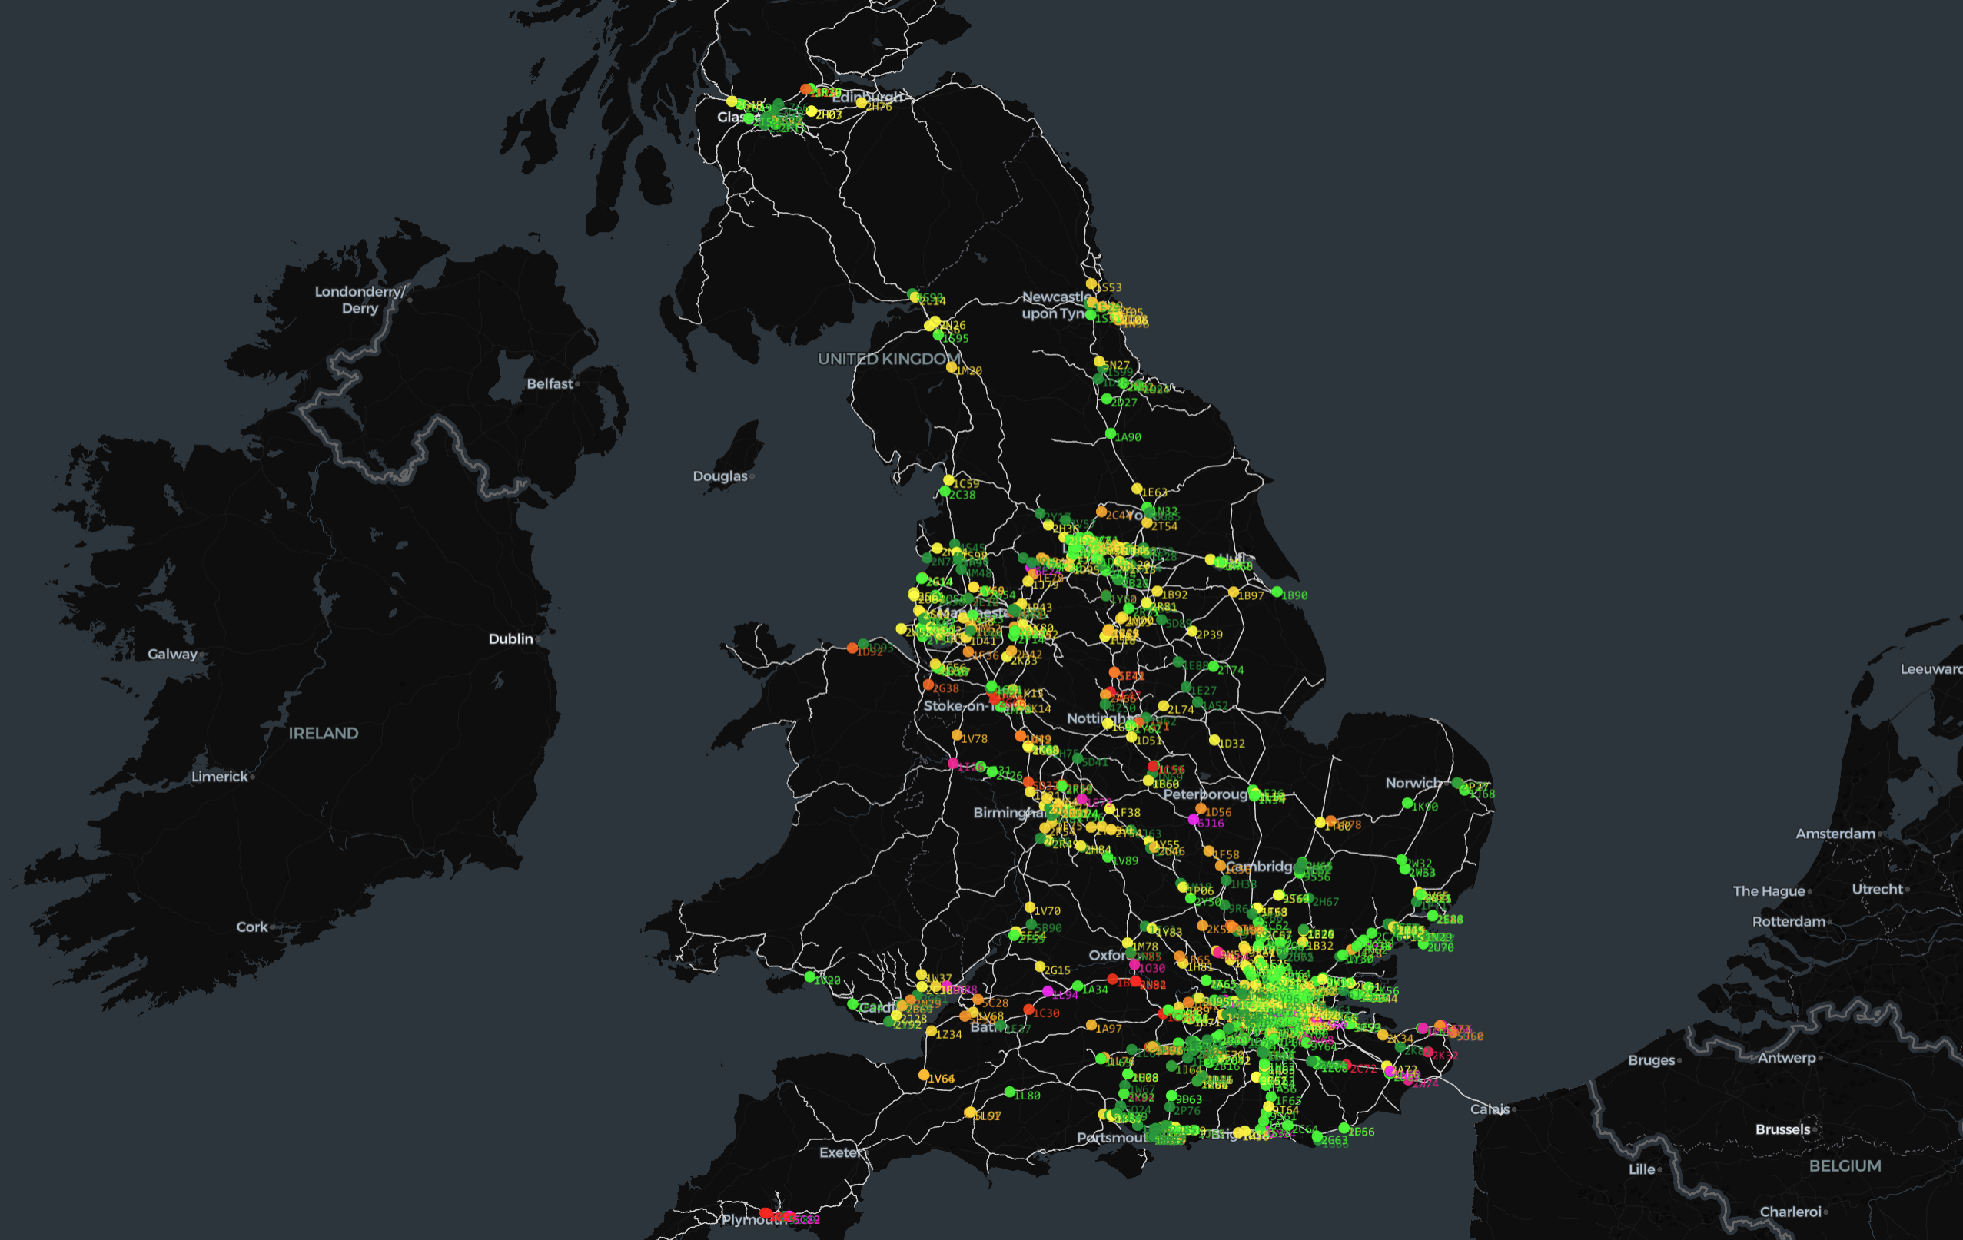
Further Work
Data Quality Improvements
Utilisation & Capacity Methods
Realtime
Incident Detection
Historical Analysis
Realtime Detection

Slide 21
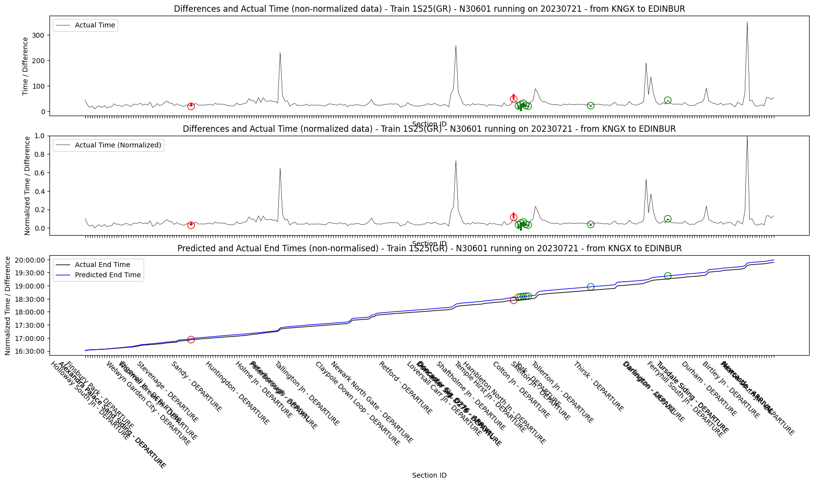
Further Work
Data Quality Improvements
Utilisation & Capacity Methods
Realtime
Incident Detection
Historical Analysis
Realtime Detection

Slide 22

Analysing Railway Infrastructure utilisation A Geospatial Approach
Any Questions?
Further details

